Slide 1



Pimp Out My Code:
SASG’s first code show and tell

Slide 2

Who dat?
Chris Newey
Repository pattern
don-E Merson
A new prize engine in SQL
Luis
Scholarship Universe Wizard
Mack
Checkbox Matrix tips
Chris
Quick Connect API
Joe
Conversion Module

Slide 3

Start of CN
Chris

Slide 4
The Repository Pattern
Mediates between domain and data mapping layers using a collection-like interface for accessing domain objects
Adds a layer of abstraction between domain objects and the data store
Allows easy changing of the persistence method (i.e. ADO.Net to web services)
Allows trivial mocking for testing
Provides separation of concerns between the domain and how its state is persisted.

Slide 5
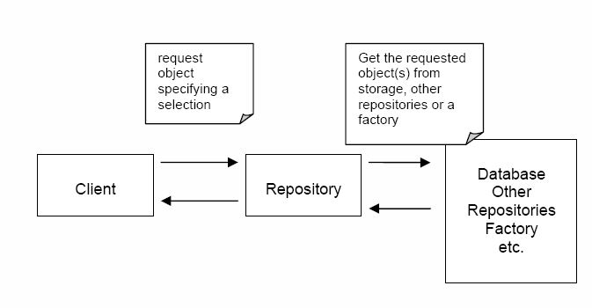
So what is it?

Slide 6
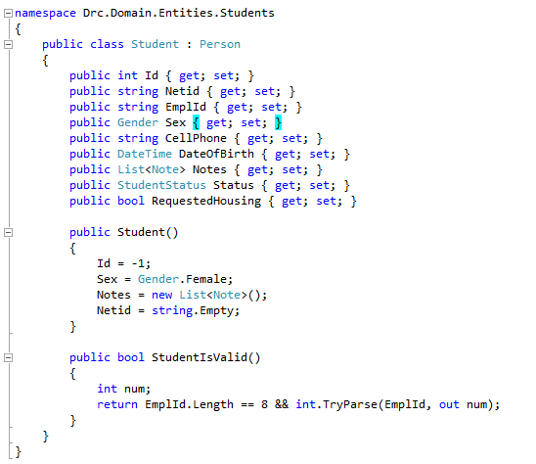
The Domain Object

Slide 7
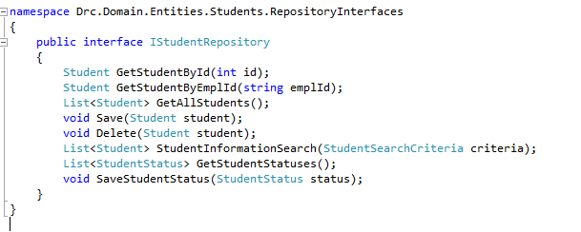
Repository Interface

Slide 8
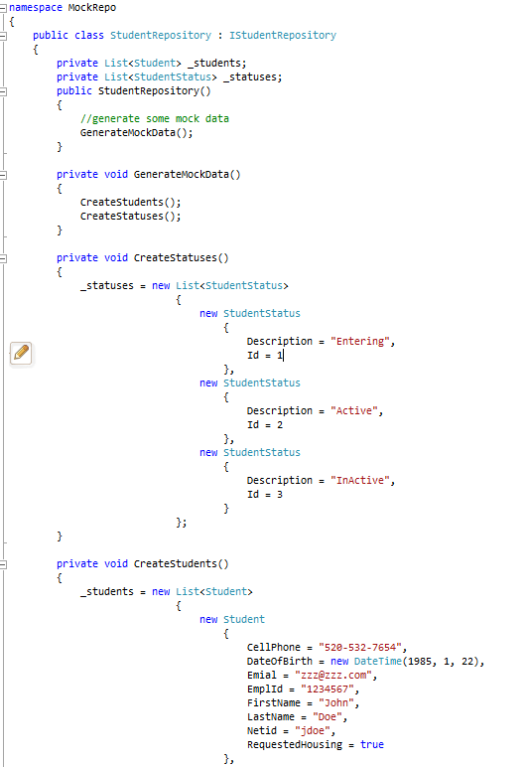
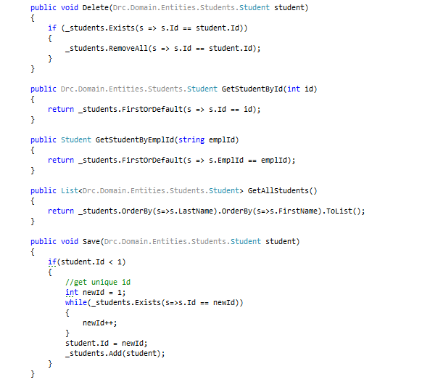
Mock Repository

Slide 9
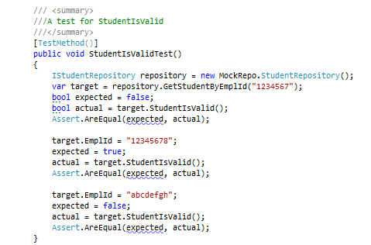
Using Mock Repository in a Unit Test

Slide 10


End of CN
Start of don-E’s boxing Gerbil project

Slide 11
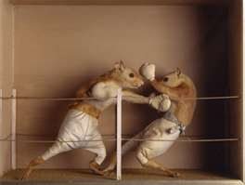
don-E
Prize Engine 2…
Types of logic
AND Clauses
A&B
OR Clauses
A | B
COMPLEX Clause
(A & B) or B
First prize engine doesn’t do this well
BRANCHs
Allows CASE WHEN STATEMENTS (IF/Then)
CodeName:
Prize Boxing Gerbil

Slide 12

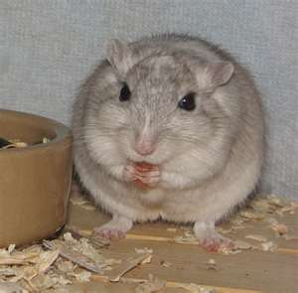
Rules
AND CLAUSE
Can only have AND children or OR Clause
If any child is not true, return false
OR CLAUSE
Can only have OR children
If any child is true, return true
COMPLEX CLAUSE
Can Have AND and OR children
If all the ANDs return true
Or
Any of the Ors return true
Then return true
If any clause comes back false, then bad, else good

Slide 13
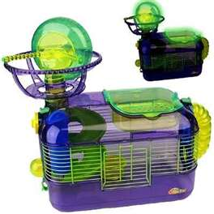
Complex mappings
A & B & (C or (D&E)) & (F or G) possible
Clauses can have parent to determine grouping
BRANCHES
Can have any clauses
If any branch returns true, it is true
If Then branches
If UGRAD, IF GRAD, If MED

Slide 14
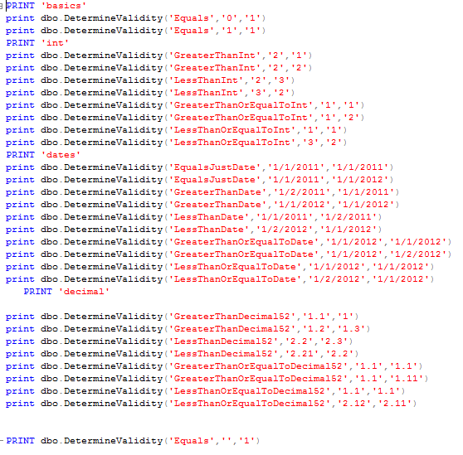
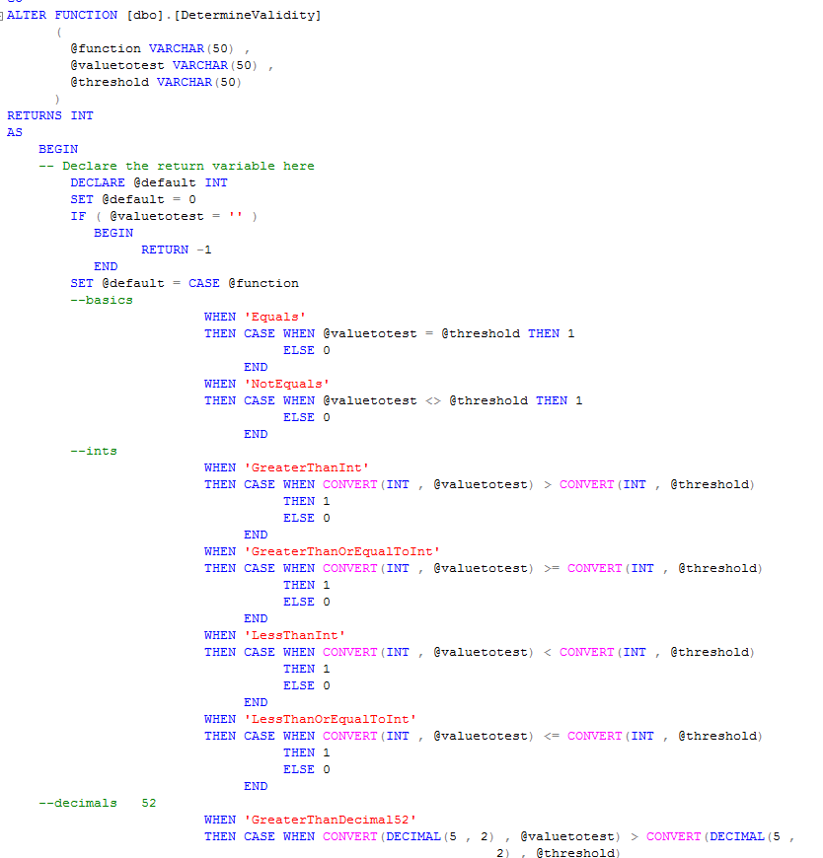

SQL Function
Case Statement

Slide 15
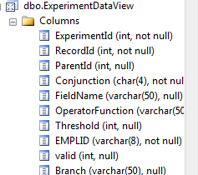

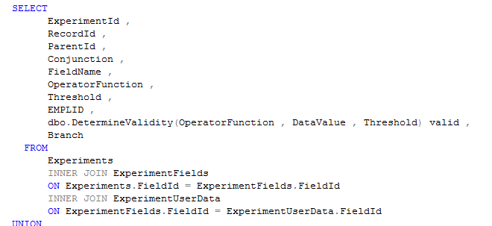
Validating Items
One big view gets answer
Only gets AND and OR due to join

Slide 16
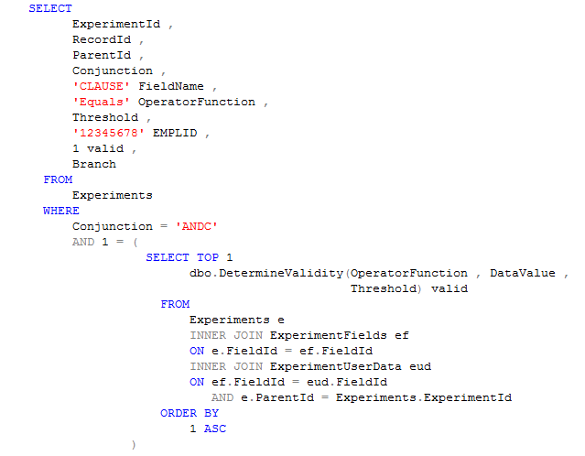
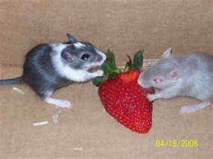
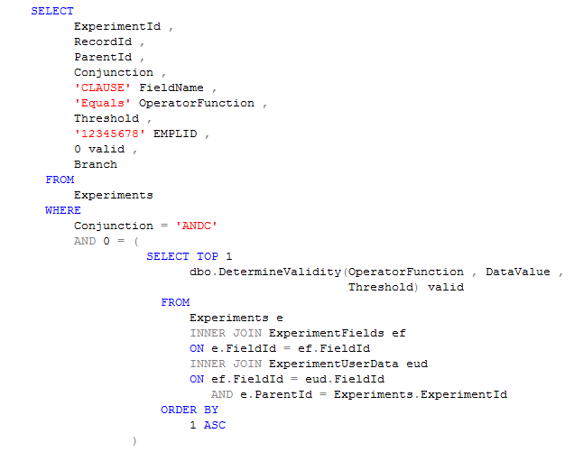
AND CLAUSE

Slide 17
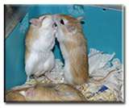
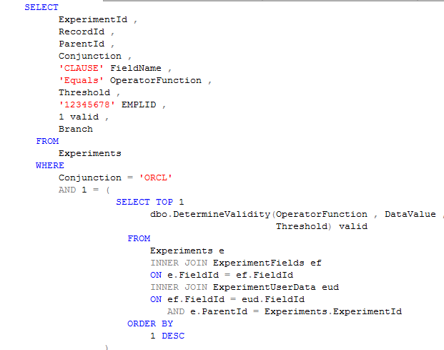
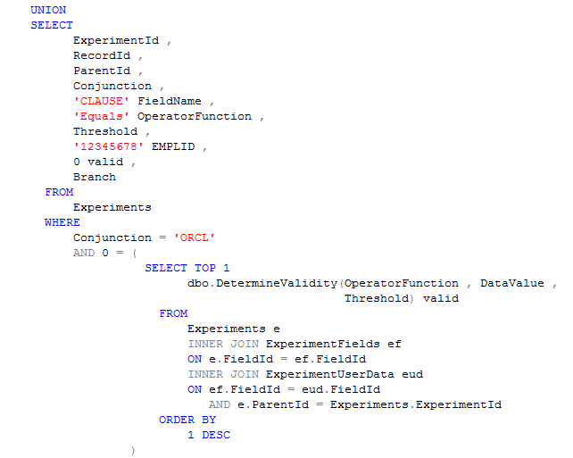
OR CLAUSE

Slide 18
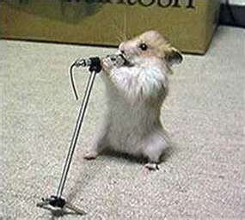
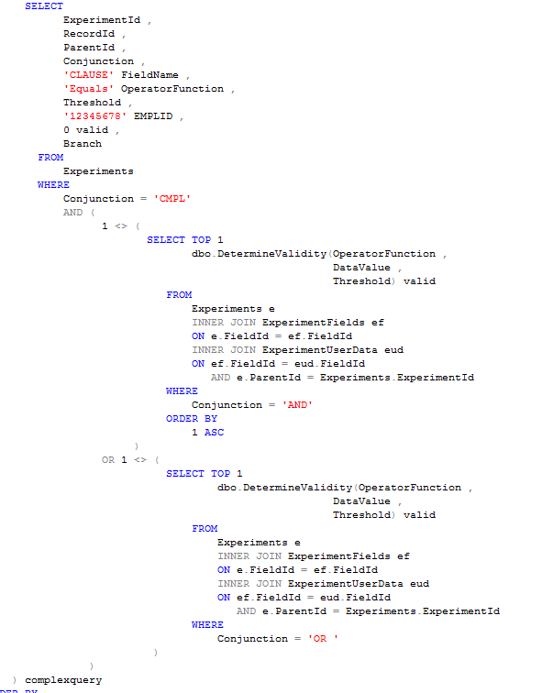
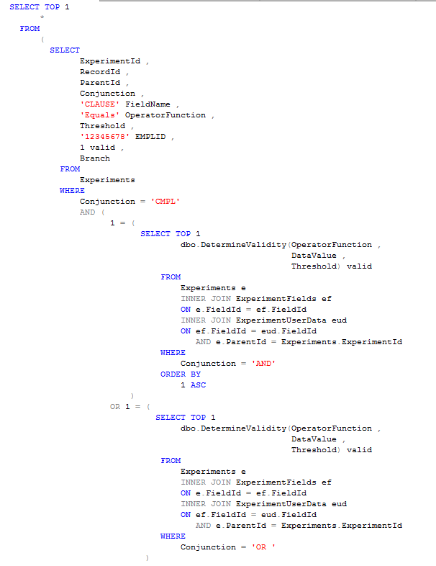
COMPLEX CLAUSE

Slide 19
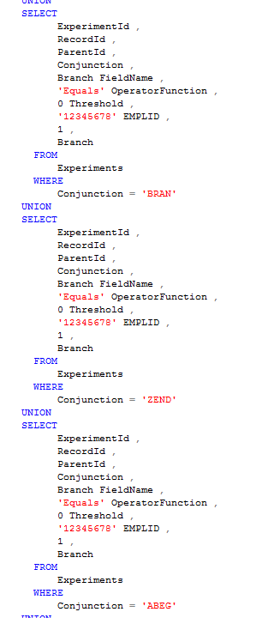
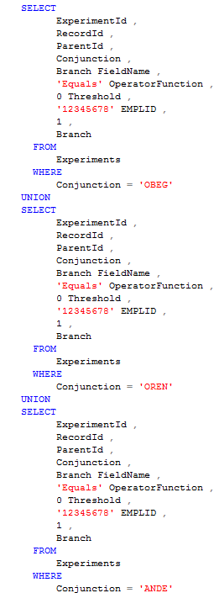

COSMETICS
Used as placeholders to determine visual elements
Boxing Gerbil

Slide 20
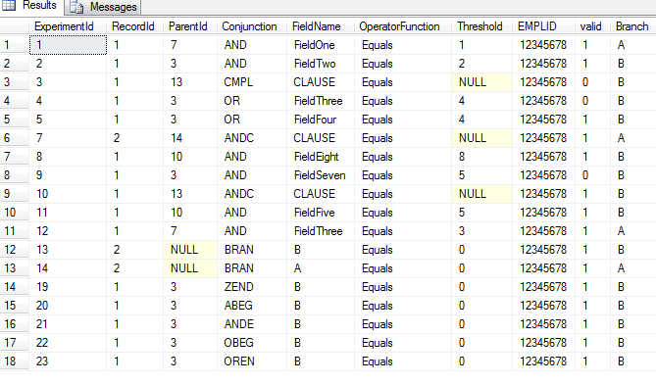

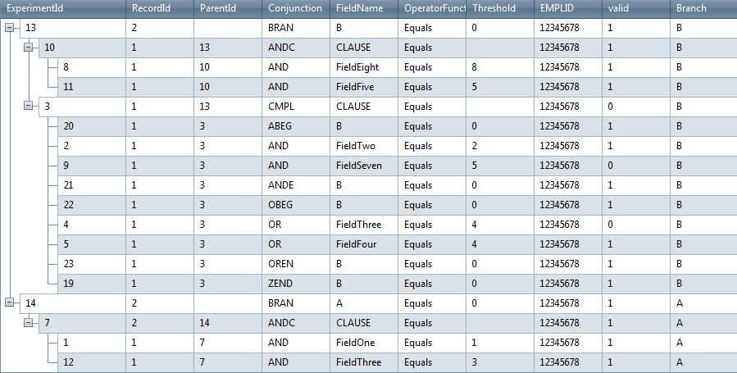
Results
Get min(valid) for answer (0 or 1) on Clause fields

Slide 21
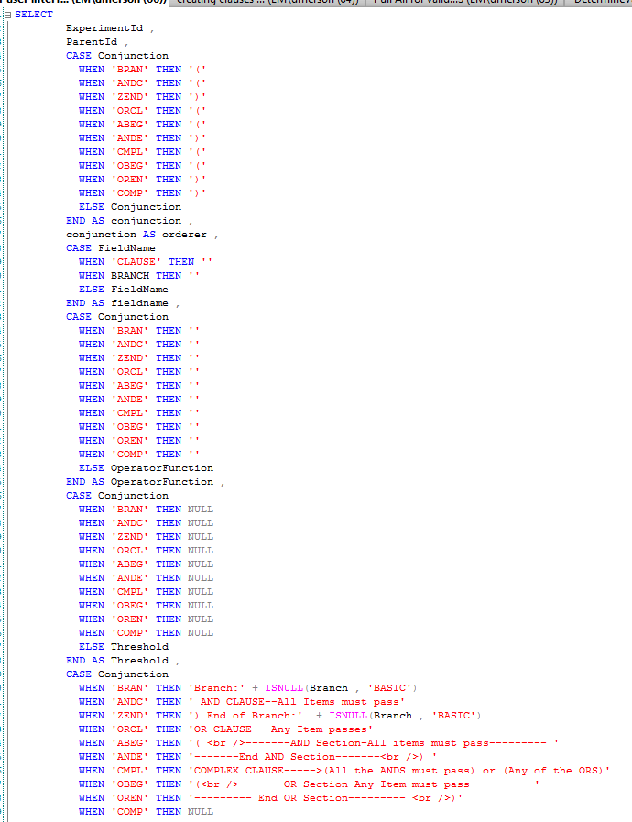

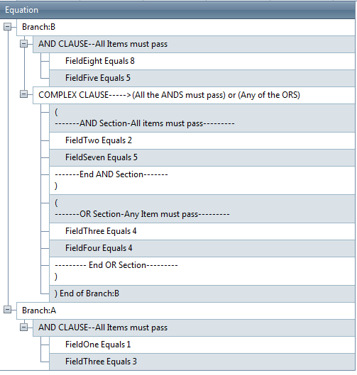
Make pretty

Slide 22


End of don-E
Luis is next

Slide 23

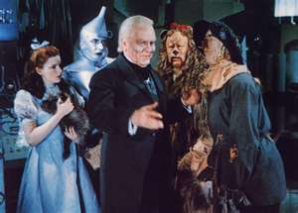
Luis
Scholarship Universe Wizard Caclulations
2 basic classes
ScholarshipPackageRequirementClass
WizardClass

Slide 24
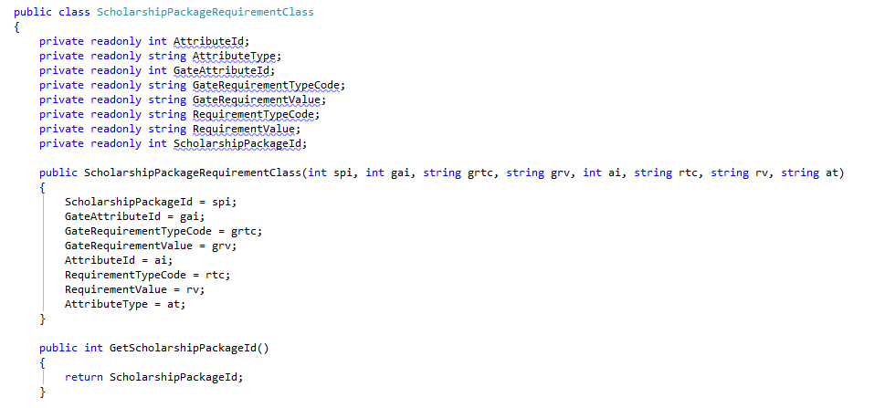
ScholarshipRequirementClass

Slide 25
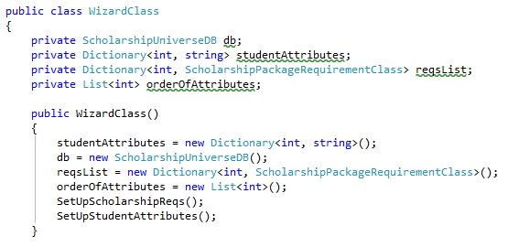
Wizard Class

Slide 26
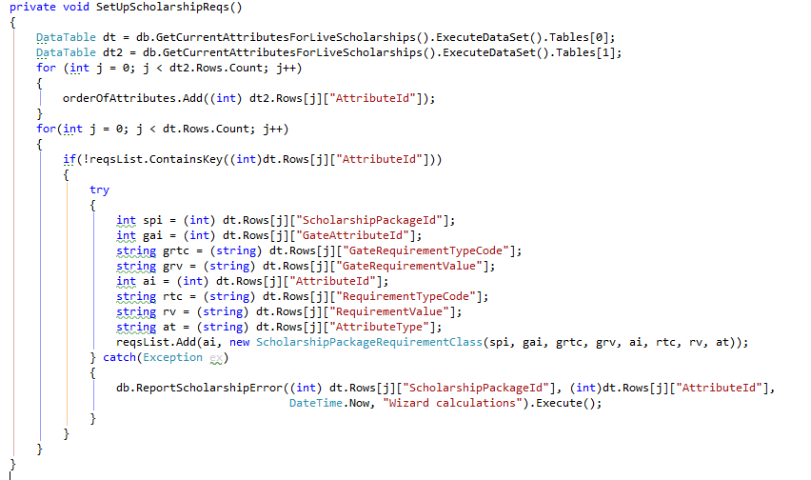
SetUpScholarshipReqs

Slide 27
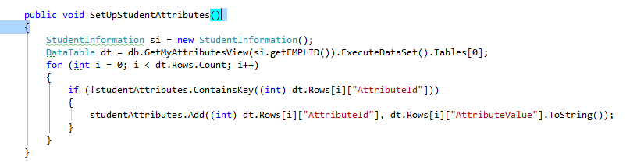
SetUpStudentAttributes

Slide 28
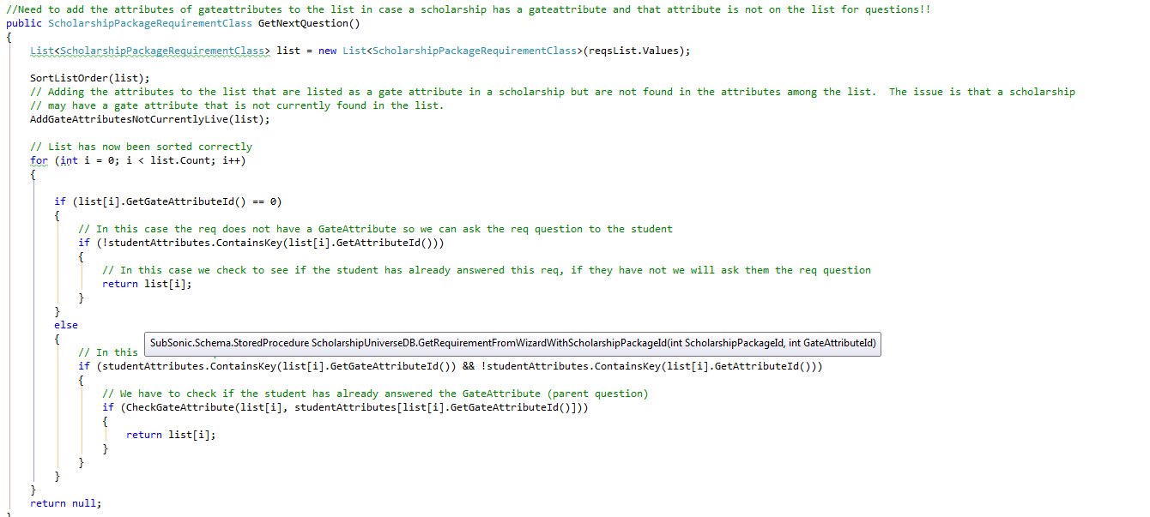
GetNextQuestion

Slide 29
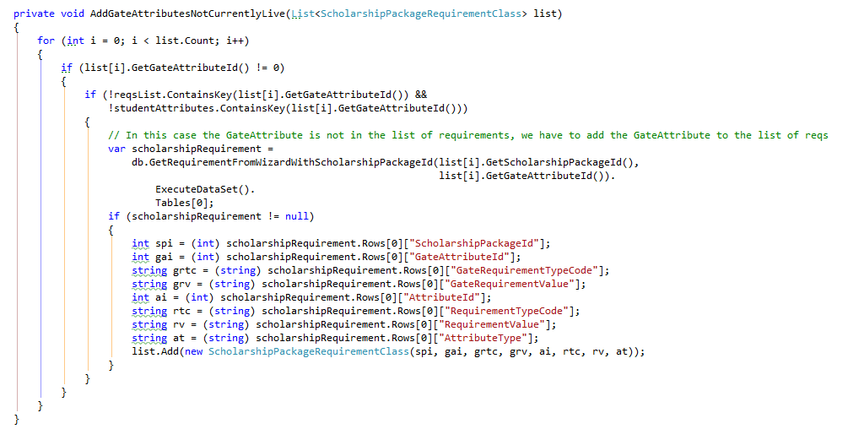
GateAttributesNotLive

Slide 30
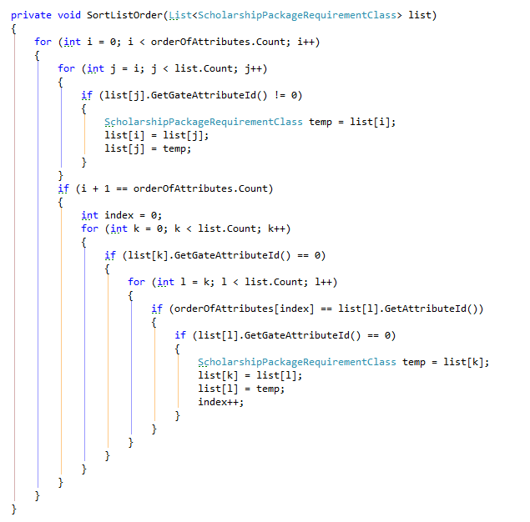
Sort List

Slide 31
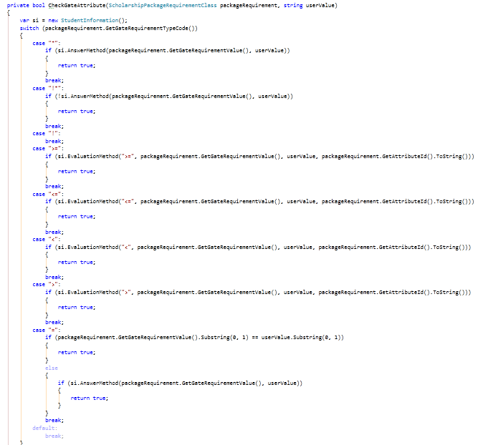
CheckGate

Slide 32
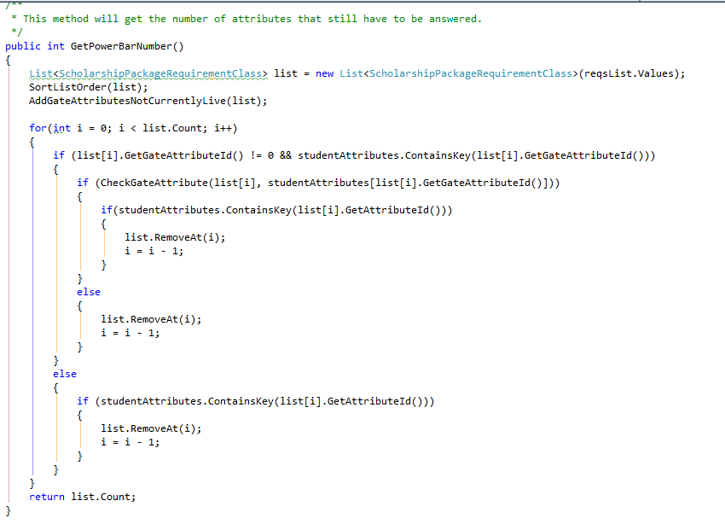
Power Bar

Slide 33


End of Luis
Start of Mack

Slide 34

Mack on Numbers
Shortcuts
Remove all non numeric characters from string
SI.Phone = new string(value.Where(c => char.IsDigit(c)).ToArray());

Slide 35
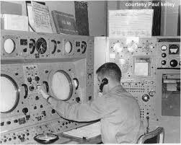
Matrix Checkbox Tricks
After working with Matrix for awhile I assumed that all checkbox values should be Y or N in the db so I used this shortcut for setting the Y’s and N’s.
IsChkBox = (chkBox.checked ? “Y” : “N”) to return Y or N depending on checkbox. (can be used in parameter list)
chkBox.checked = (IsChkBox == “Y” ? true : false) to set the checkbox based on SQL column.

Slide 36
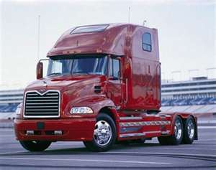

End of Mack
Start of CB

Slide 37
Quick Connect API
Simple, Real-Time Interaction with Connect

Slide 38
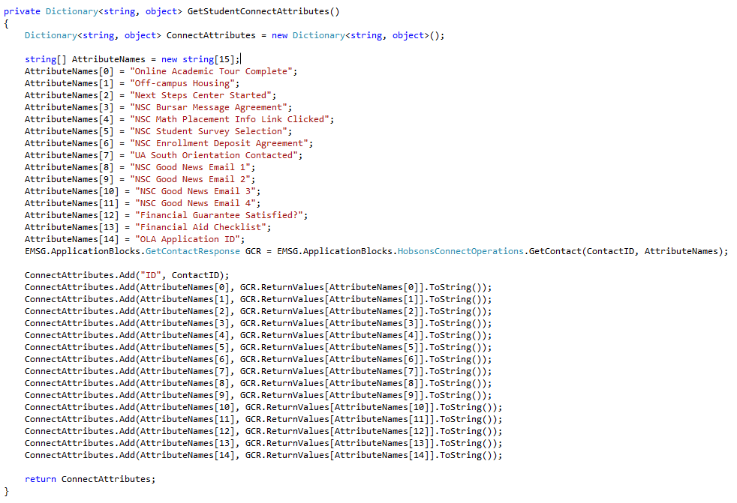
Making the Call (Next Steps)

Slide 39
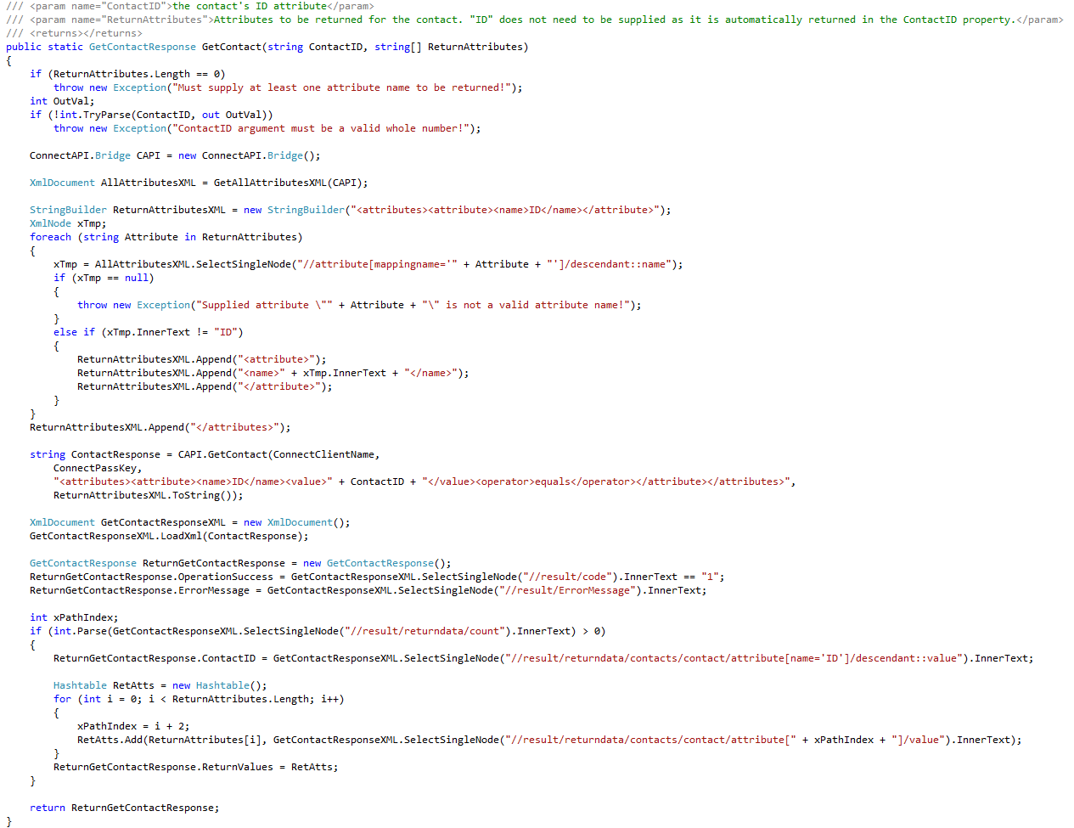
What’s Happening Under the Hood

Slide 40
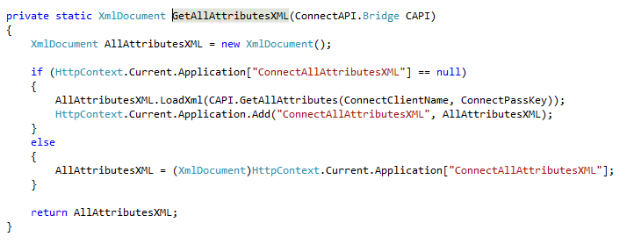
What’s Happening Under the Hood

Slide 41
What’s Happening Under the Hood

Slide 42
What’s Happening Under the Hood

Slide 43
What’s Happening Under the Hood

Slide 44
Handling the Response (Next Steps)

Slide 45


End of CB
Start of Joe

Slide 46
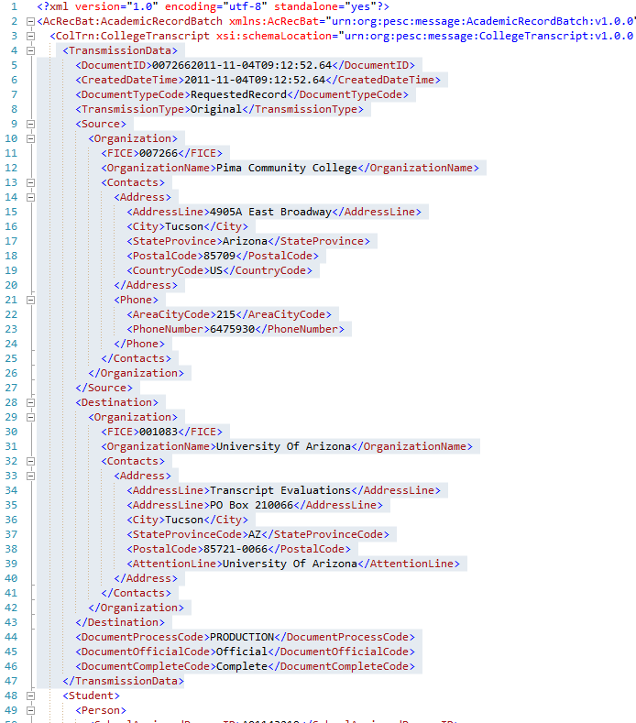

Slide 47
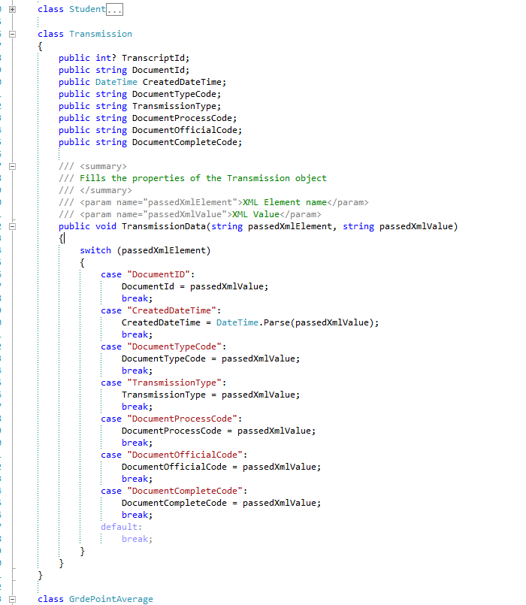

Slide 48
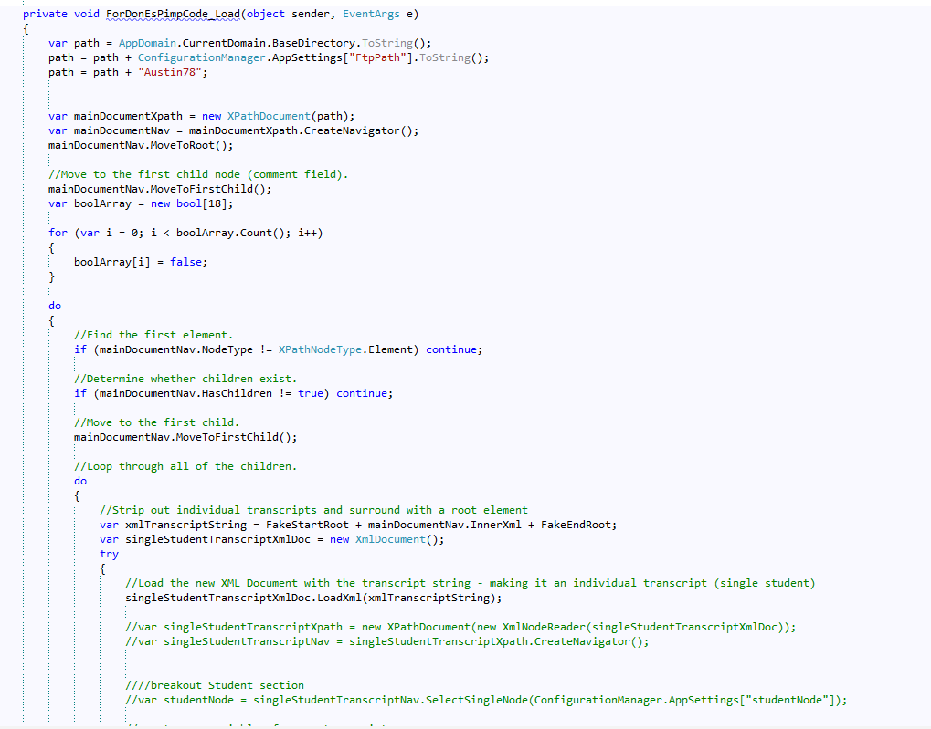

Slide 49
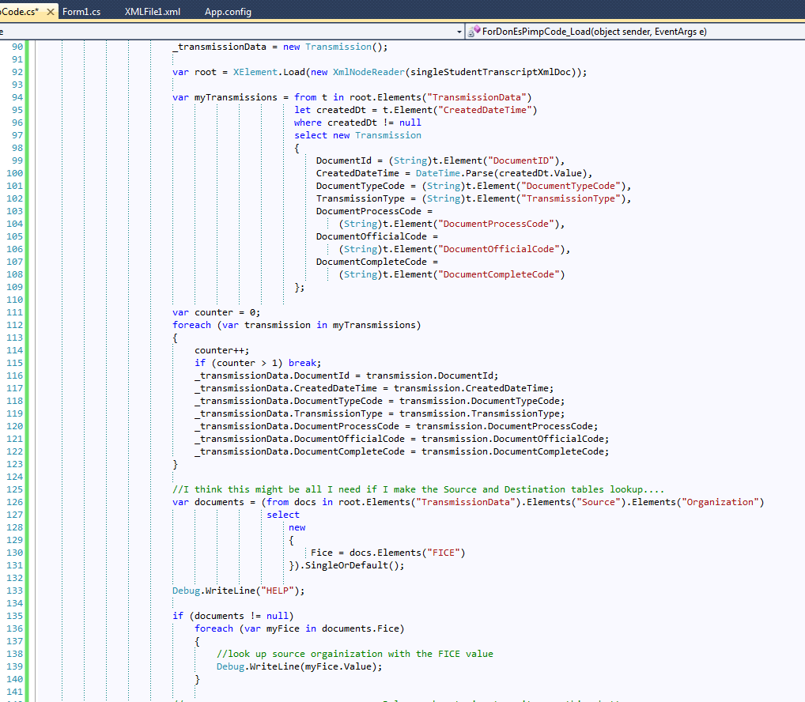

Slide 50
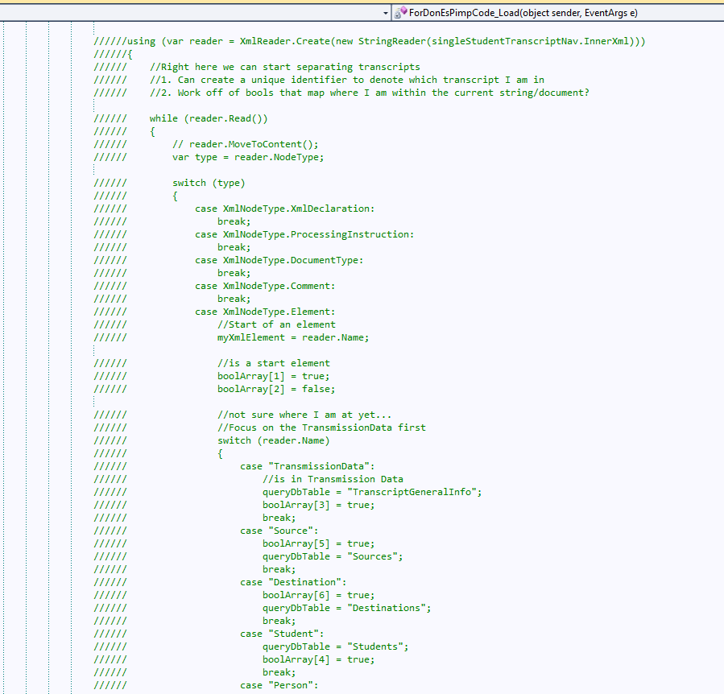

Slide 51
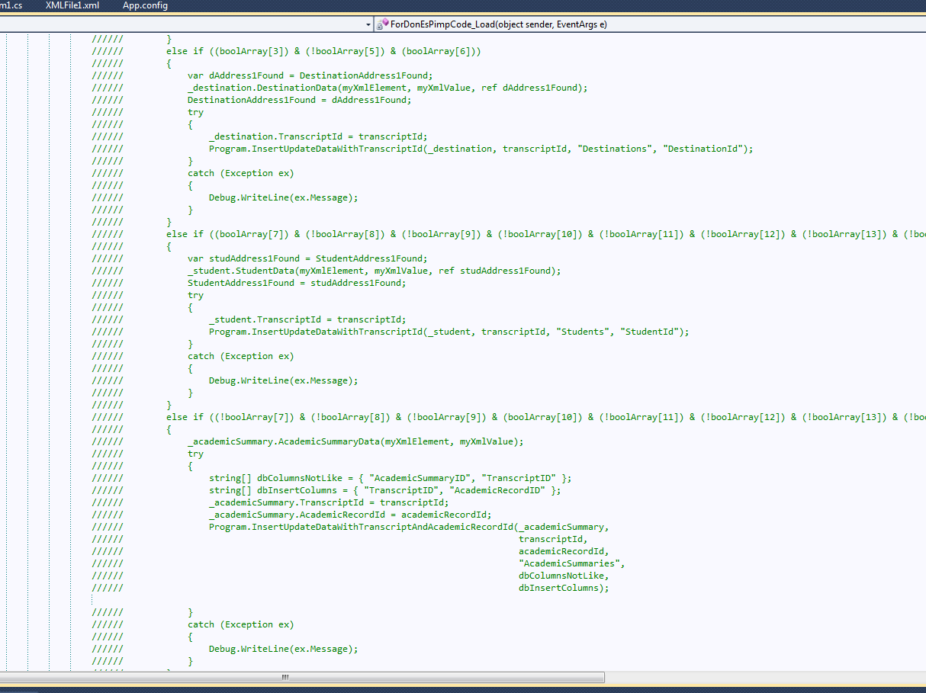

Slide 52
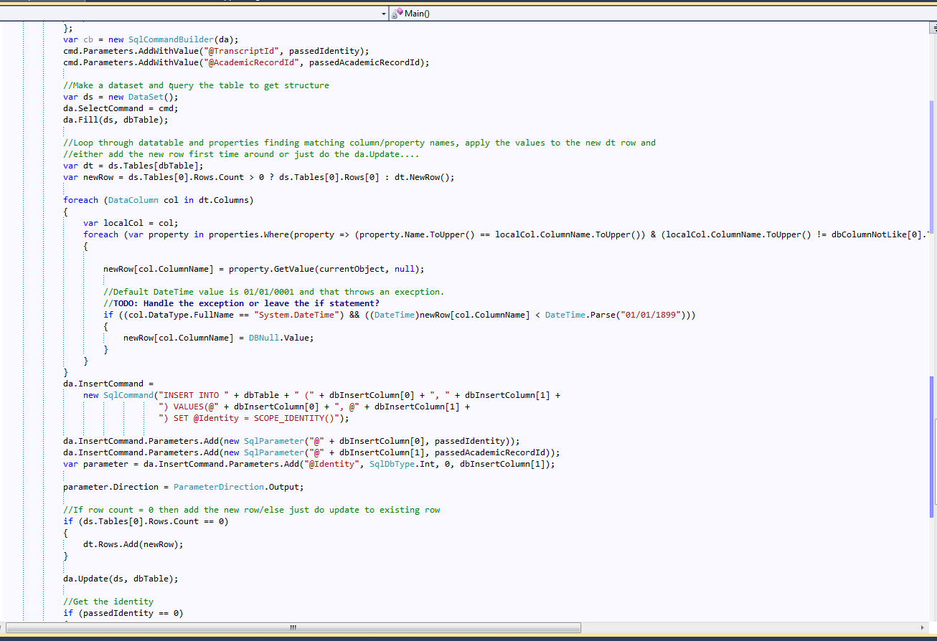

Slide 53

End of Joe
End of presentation

Slide 54


Rebecca’s Shameless Plug For…
No… it’s not a komodo dragon customizer.
(That would be Photoshop)

Slide 55



Visualize your code
Nifty custom colors

Slide 56

Tasty Options
It’s not JUST for visuals
Handles virtually ANY coding language…

Slide 57


Watch your language
…Even the developing ones.
And it keeps up to date.

Slide 58


Code Intelligence
It knows your variables, functions, etc.
Komodo says: Let me get that for you…

Slide 59

That’s all.

